Slide 1
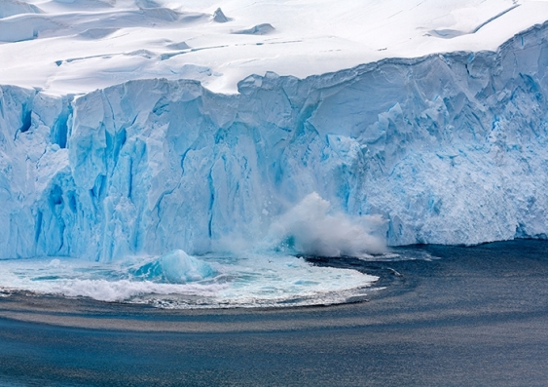
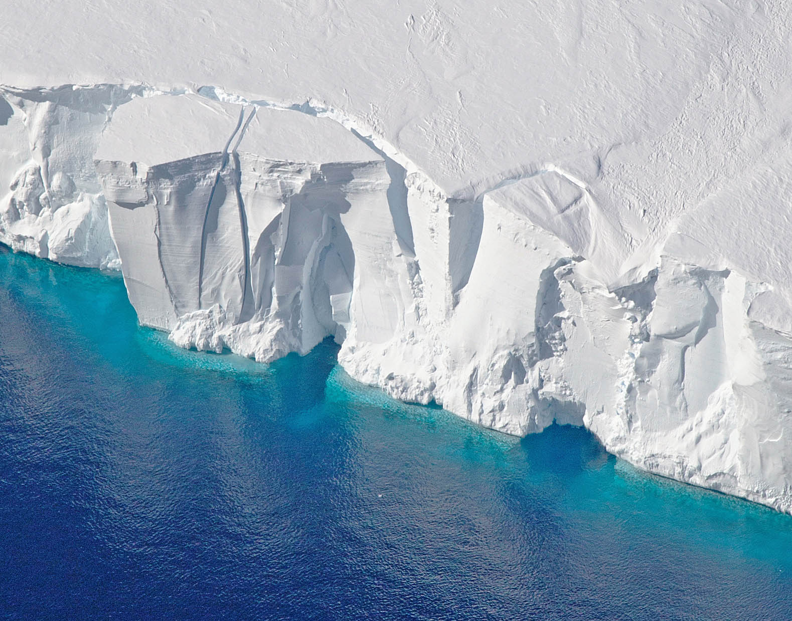
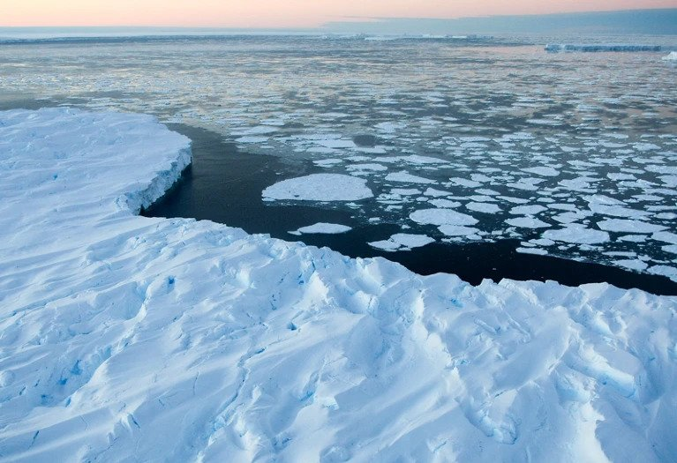
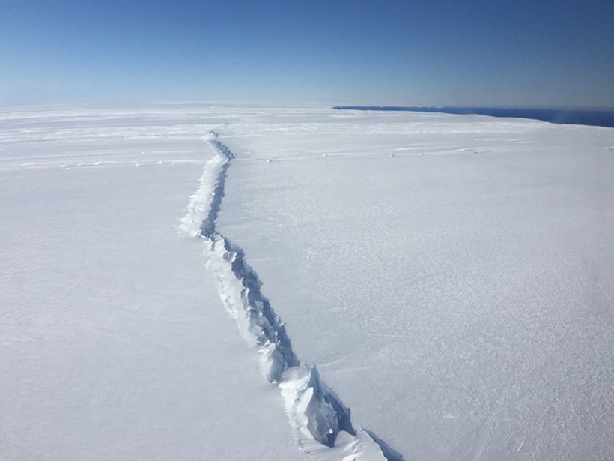
Multi-fidelity experimental design for ice-sheet models
Pierre Thodoroff
Notes:
with british antarctic survery

Slide 2
AGENDA
Ice-sheet models
Theoretical insights
Future directions/projects
Multi-fidelity experimental design
Applications to PDE and ice-sheet

Slide 3
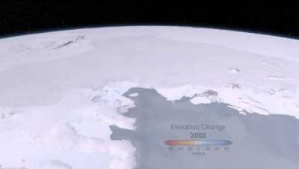
WHAT ARE Ice-sheet models?
Notes:
This is the sea we are working on.

Slide 4
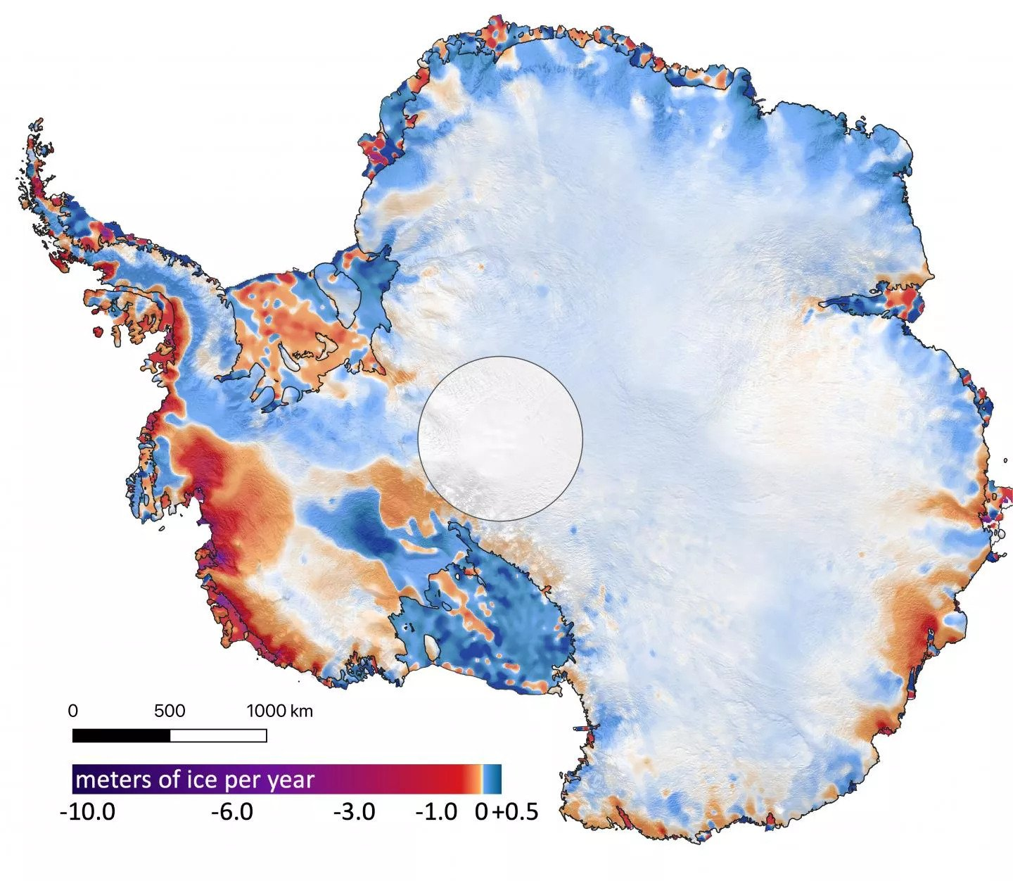
WHY ARE THEY USEFUL?
Predicting the melting of the ice-sheet and the contribution to the sea level.
Ice-sheet are not stationary ice cubes. They move, deform and melt through time.
Interesting facts:
If all the ice melt -> 60 meters increase in sea level.
Thickness of the ice at the deepest point is approximately 15 Eiffel tower!
4
Notes:
What the contribution is going to be in the next 10,20,50 years?

Slide 5
Modelling ice-sheet movement
Goal: predict the velocities at any spatial location in the future.
Secondary goal: predict the shape of the ice sheet.
Two components to consider:
Mass change such as the melting or accumulation of ice.
Physical forces such as gravity, friction with the bedrock (basal drag).
Physical model: fluid moving through time (Stokes flow)
Notes:
Both on the surface but also underneath.
what is its 3d shape?
Ice is resting on a bedrock and that cause friction.
Context of this talk stokes flow not that important to knwo

Slide 6
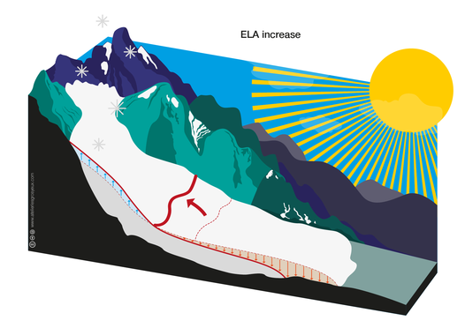
Ice-sheet 101: MASS BALANCE
Positive mass: snowfall
Negative mass: melting
Simplified model

Slide 7
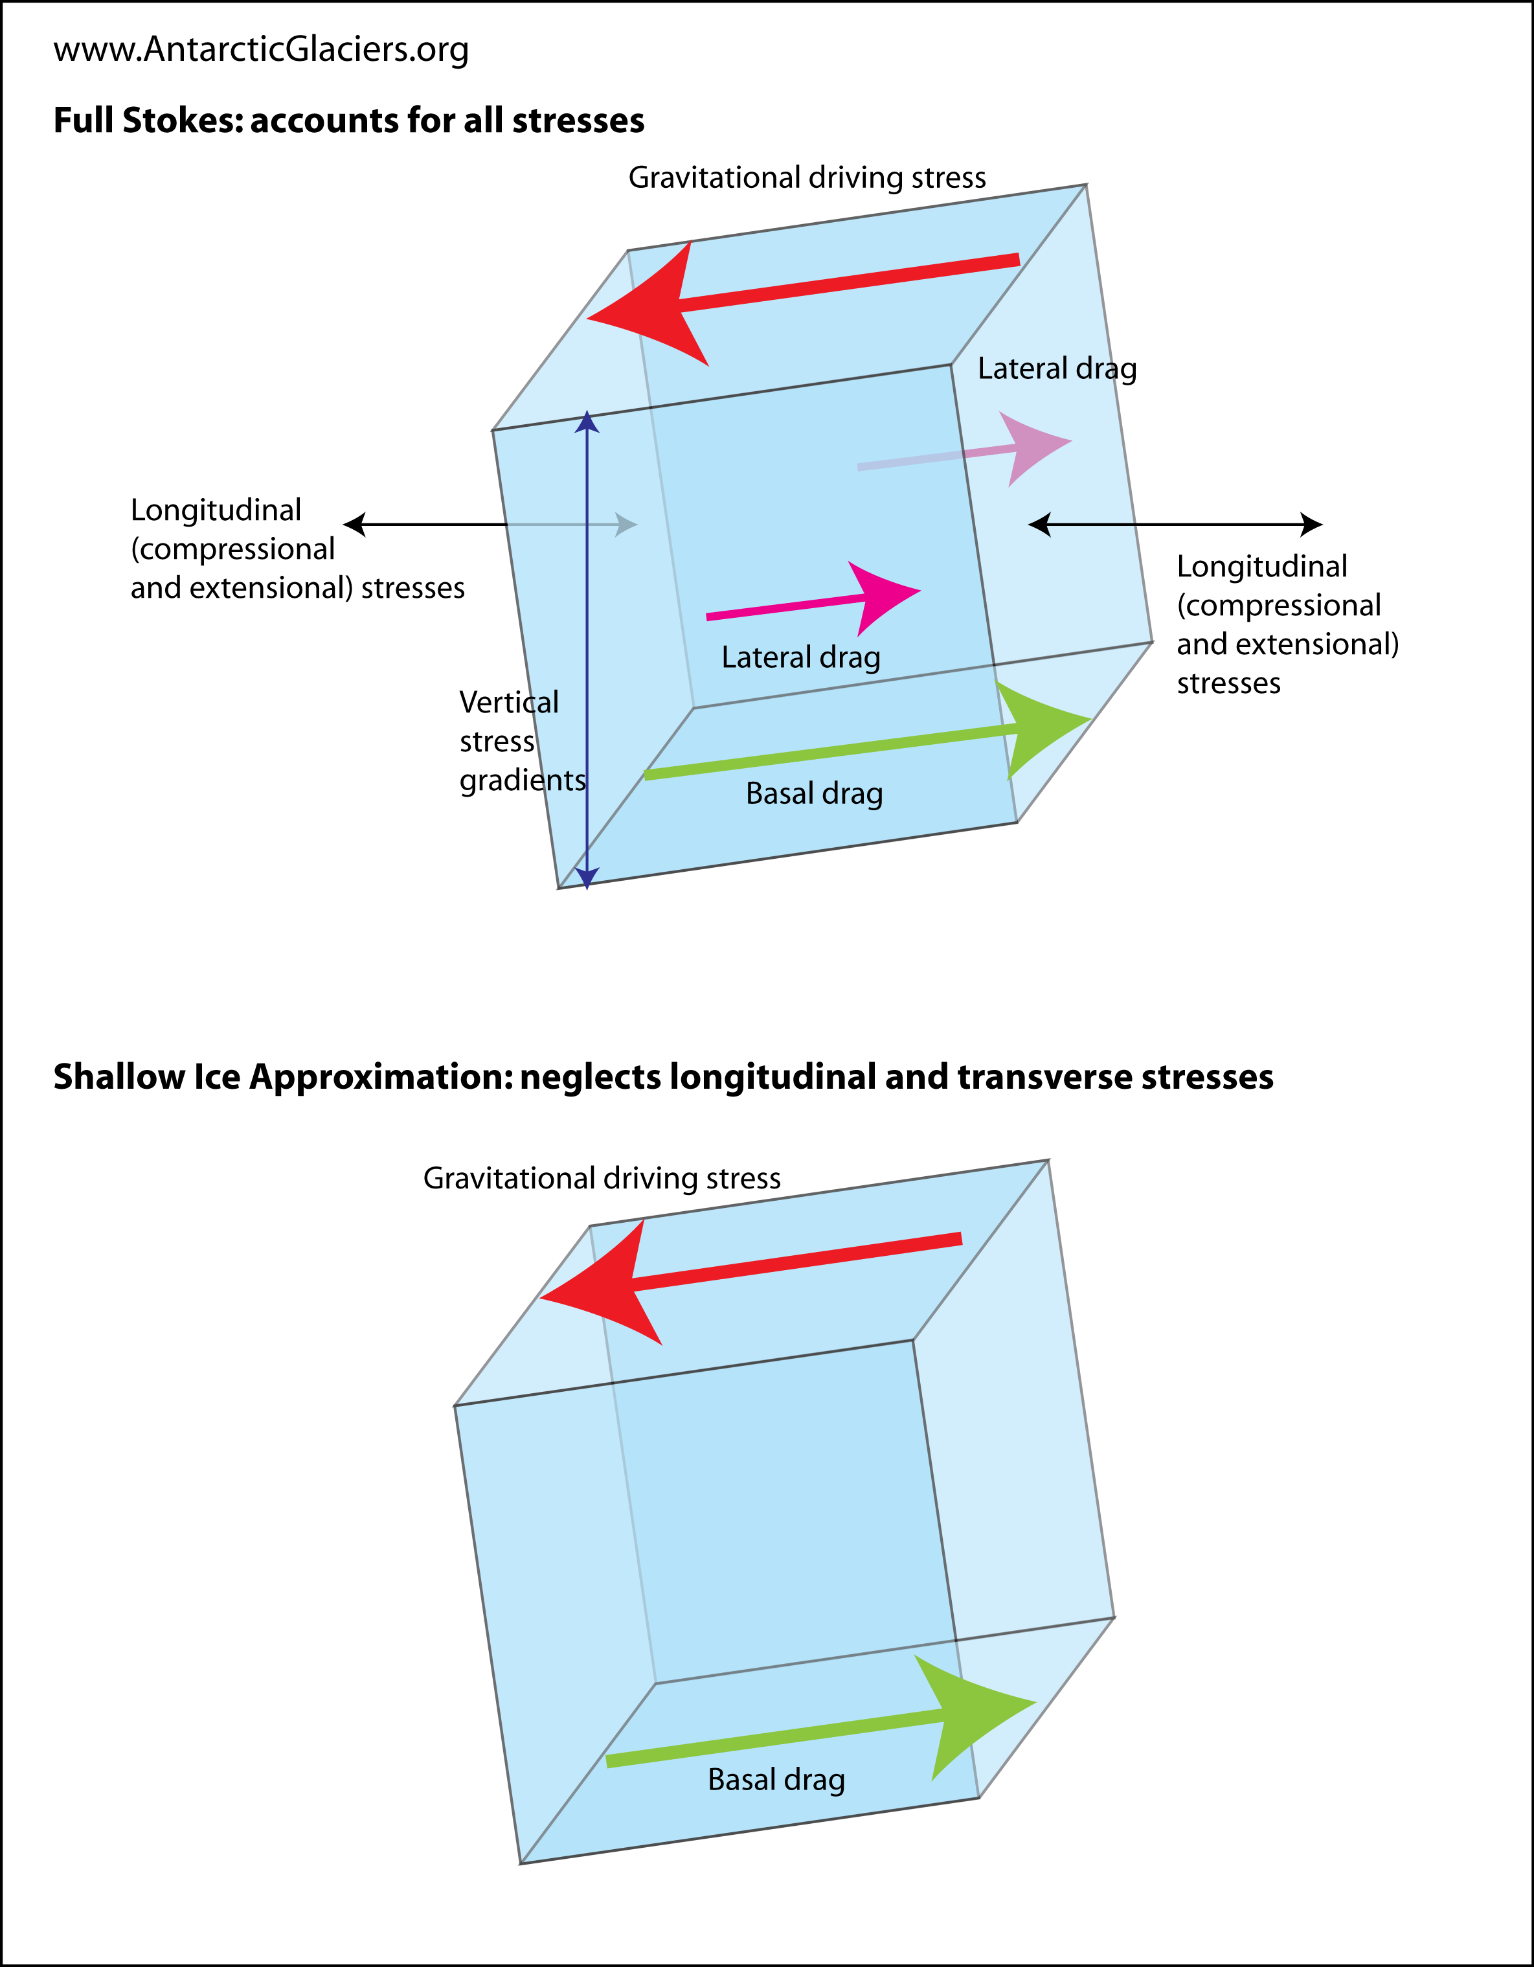
Ice-sheet 101: PHYSICAL FORCES
Notes:
Inverse problem trying to infer the bedrock
Both data driven (data assimilation) and physical. Basic PDE, learn the parameters.

Slide 8
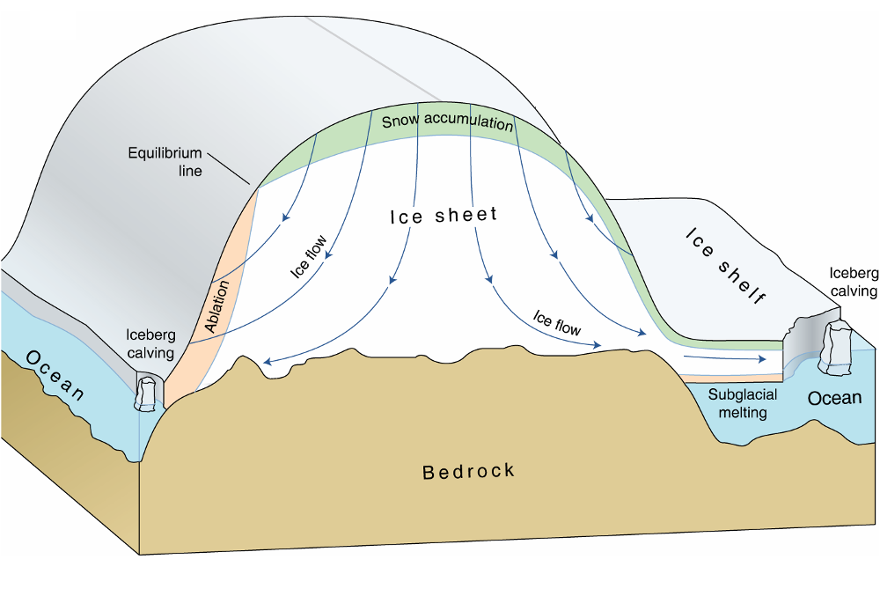
Ice-sheet 101: SUMMARY
Mass balance: snow accumulation on top and melting at the bottom.
External forces: basal drag, gravity.
Model movement and shape as a viscuous fluid moving through time (Stokes flow).
Notes:
We dont know what the bedrock looks like so a lot of the effort is inferring the bedrock (inverse problem).

Slide 9
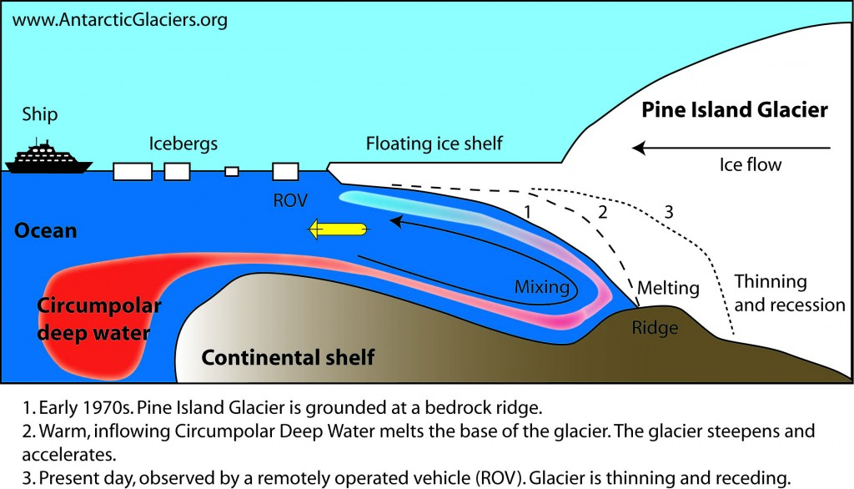
Melting of ICE
Notes:
Most of the melting happens with the surface thats touching with the water.
Thats how we use the model to predict melting.

Slide 10
GoaL: predict Sea level contributions
Run the ice-sheet model forward for 100 years and predict the contribution to sea level (SLC) from the melting.
Uncertainty over many parameters: bedrock, precipitation, melting rate.
Require forward runs over many input parameters.
Probabilistic estimate of the contribution to sea level.

Slide 11
Computational costs
Unknown bed rock (basal drags), physical constraints and various forces to consider.
Simulation is computationally expensive (inverse problem).
Running high-resolution model (small grid) can take several weeks.
Required to run the model over various initial states and parameters.

Slide 12
Computational optimization
Numerical solvers rely on temporal and spatial discretization to solve differential equations (no closed-form solution).
Computational cost is correlated with the resolution used and the accuracy of the model.
How small should my grid be to accurately estimate the contribution to sea level?
Project: optimize the accuracy/cost ratio of running the simulator.
Notes:
A resolution at 1km is going to be a lot more costly than a resolution at 5km.
2km would take several weeks.
Intuitively maybe we can get away with running low resolution for some parameters.

Slide 13
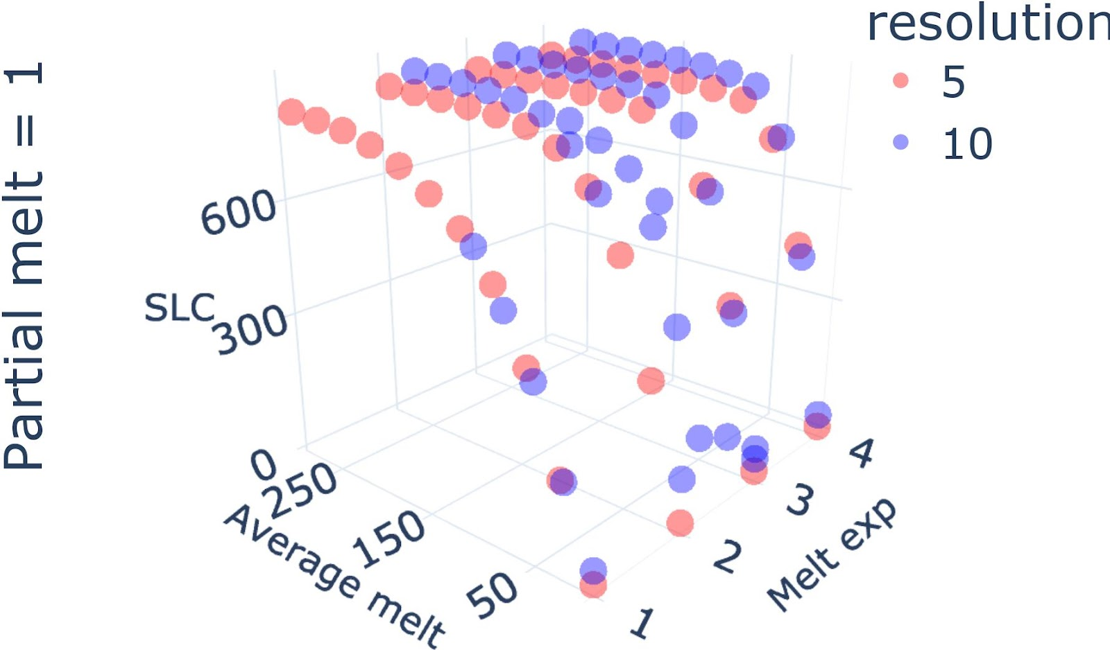
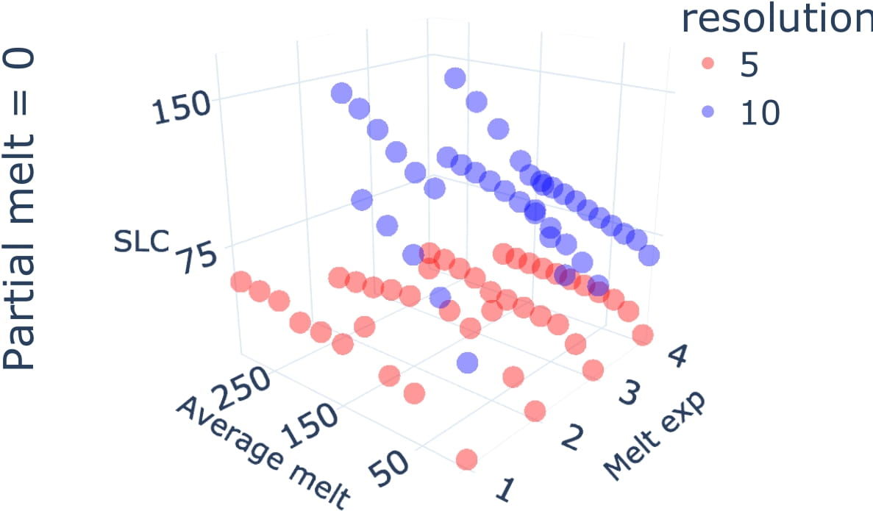
Ice-sheet data

Slide 14
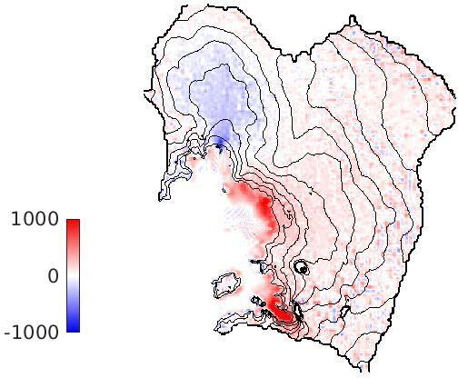
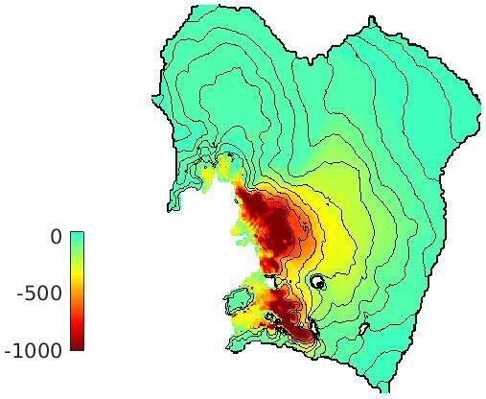
RESOLUTION DEPENDENCY
Left: modelled ice thickness change (in metres) over 100 years. Right: the difference in modelled ice thickness between a 10 km and a 3 km simulation.
Notes:
Difference between low and high resolution is really big

Slide 15
ML agenda
Intro to multi-fidelity experimental design (MFED)
Theoretical insights
Jupyter notebook applying MFED to simple PDE
Interesting projects and extensions
Notes:
Need to add somewhere. Combination of sensitivity analysis and experimental design.
Combine lecture 4 and 5

Slide 16
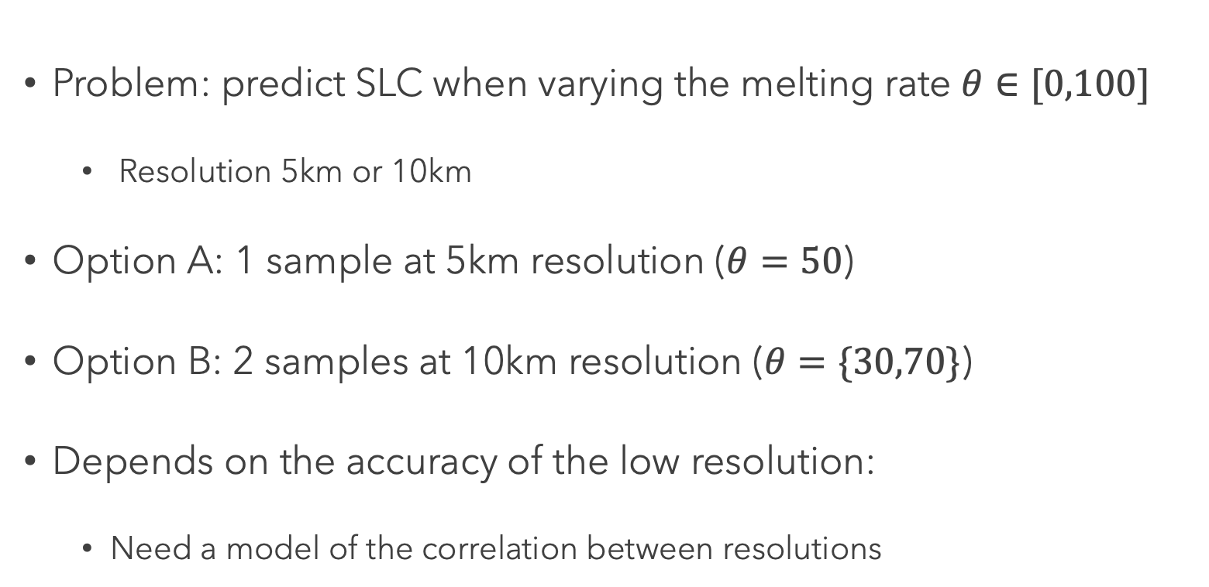
TOY EXPERIMENT
Problem: predict SLC when varying the melting rate $θ∈[0,100]$
Resolution 5km or 10km
Option A: 1 sample at 5km resolution ($θ=50$)
Option B: 2 samples at 10km resolution ($θ=\{30,70\}$)
Depends on the accuracy of the low resolution:
Need a model of the correlation between resolutions

Slide 17
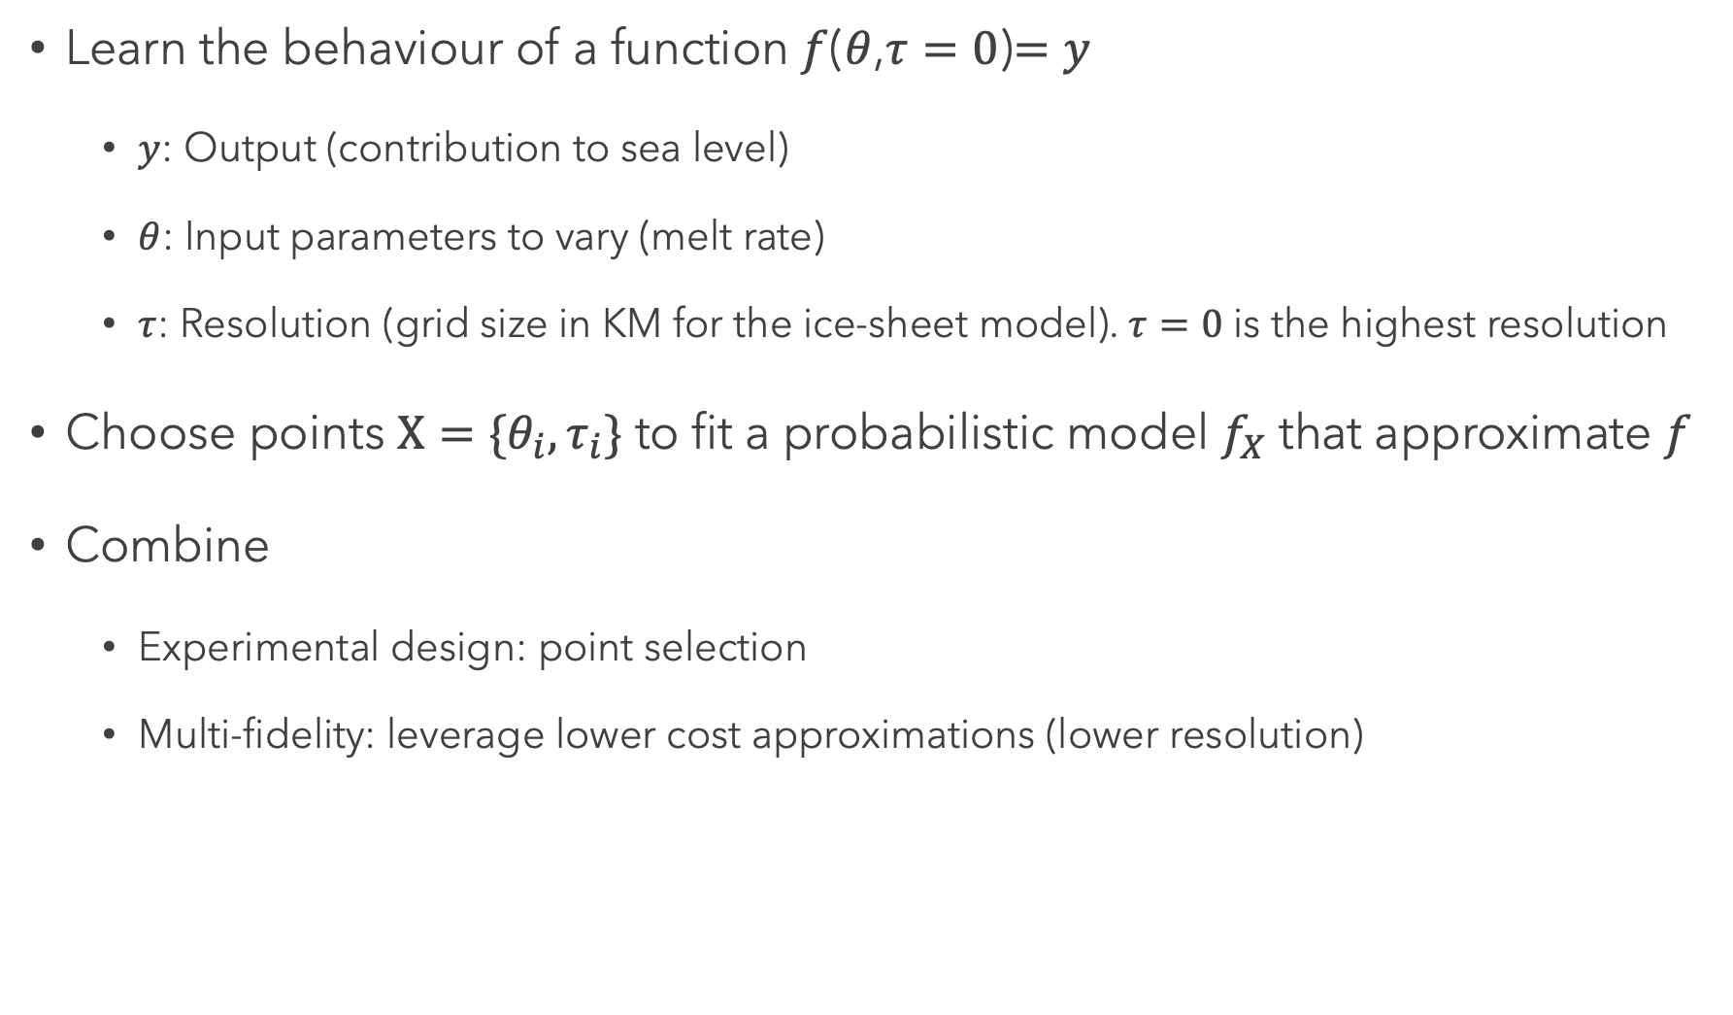
Objective
Learn the behaviour of a function $f$($θ$,$τ=0$)$=y$
$y$: Output (contribution to sea level)
$θ$: Input parameters to vary (melt rate)
$τ$: Resolution (grid size in KM for the ice-sheet model). $τ=0$ is the highest resolution
Choose points $X=\{θ_{i},τ_{i}\}$ to fit a probabilistic model $f_{X}$ that approximate $f$
Combine
Experimental design: point selection
Multi-fidelity: leverage lower cost approximations (lower resolution)
Notes:
We are only interested in learning the behaviour of the function at the highest resolution.

Slide 18
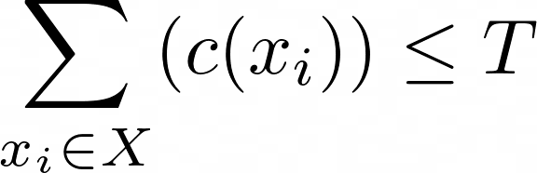
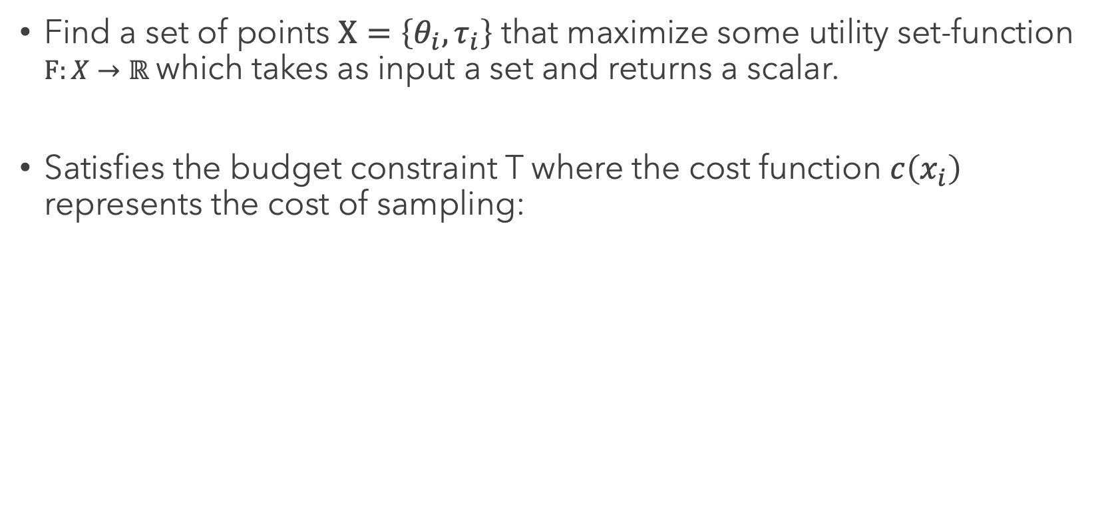
Constrained objective
Find a set of points $Χ=\left\{θ_{i},τ_{i}\right\}$ that maximize some utility set-function $F:X→ℝ$ which takes as input a set and returns a scalar.
Satisfies the budget constraint T where the cost function $c\left(x_{i}\right)$ represents the cost of sampling:
Notes:
Set-function
Constraint is important otherwise can just query the highest resolution and you're done.

Slide 19
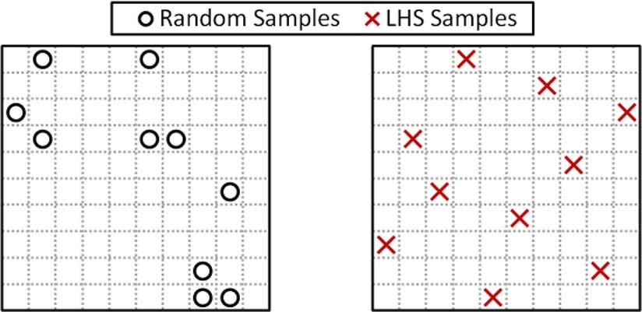
Refresher: Experimental design
Goal: choose input points to learn as much as possible about a function.
Space-filling design: choose points that maximize a distance metric between points.
Latin hypercube sampling

Slide 20
Issue with space-filling design
Fail to model functions that have non-stationary behavior.
Part of the space might be more complex to model and require finer grain resolution.
Hard to input user requirements:
In ice-sheet we might only care about areas of the function above a certain threshold.
Does not assign a value to a point which makes it complicated to compare points of different resolutions (more on that later).
Notes:
User requirements: You are only looking at the input not the output

Slide 21
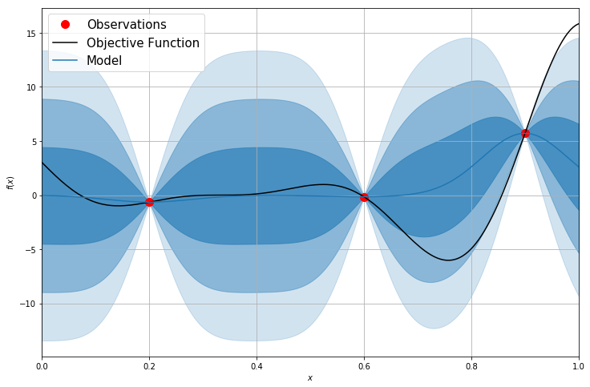
Model-based ED
Fit a probabilistic model (GP) of f on the datapoints collected.
Select points to minimize the uncertainty of the GP:
Integrated variance reduction
See lecture 4 if you have any doubts.

Slide 22
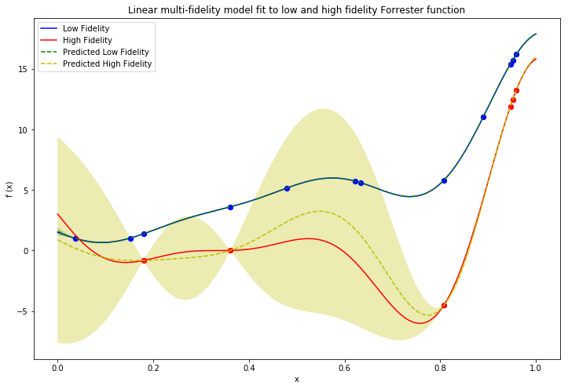
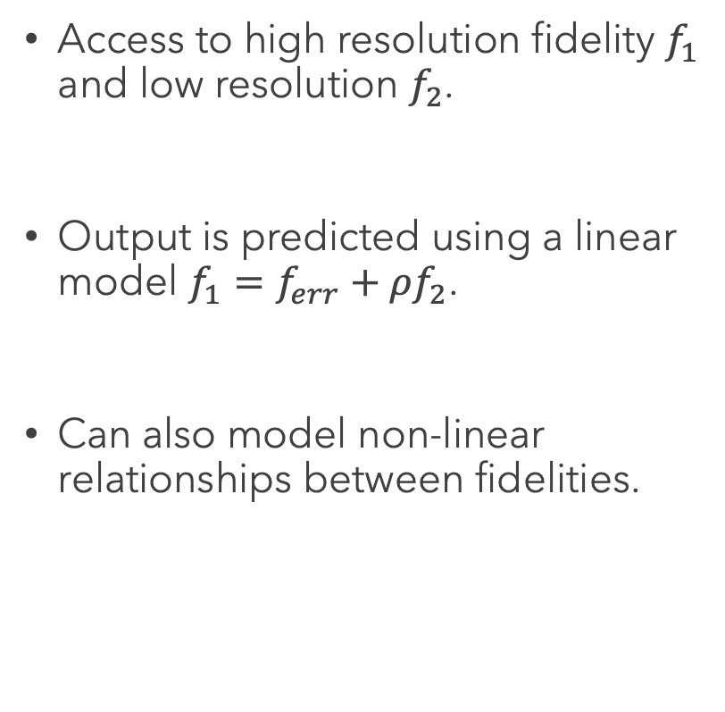
REFRESHER: Discrete Multi-fidelity
Access to high resolution fidelity $f_{1}$ and low resolution $f_{2}$.
Output is predicted using a linear model $f_{1}=f_{err}+ρf_{2}$.
Can also model non-linear relationships between fidelities.

Slide 23
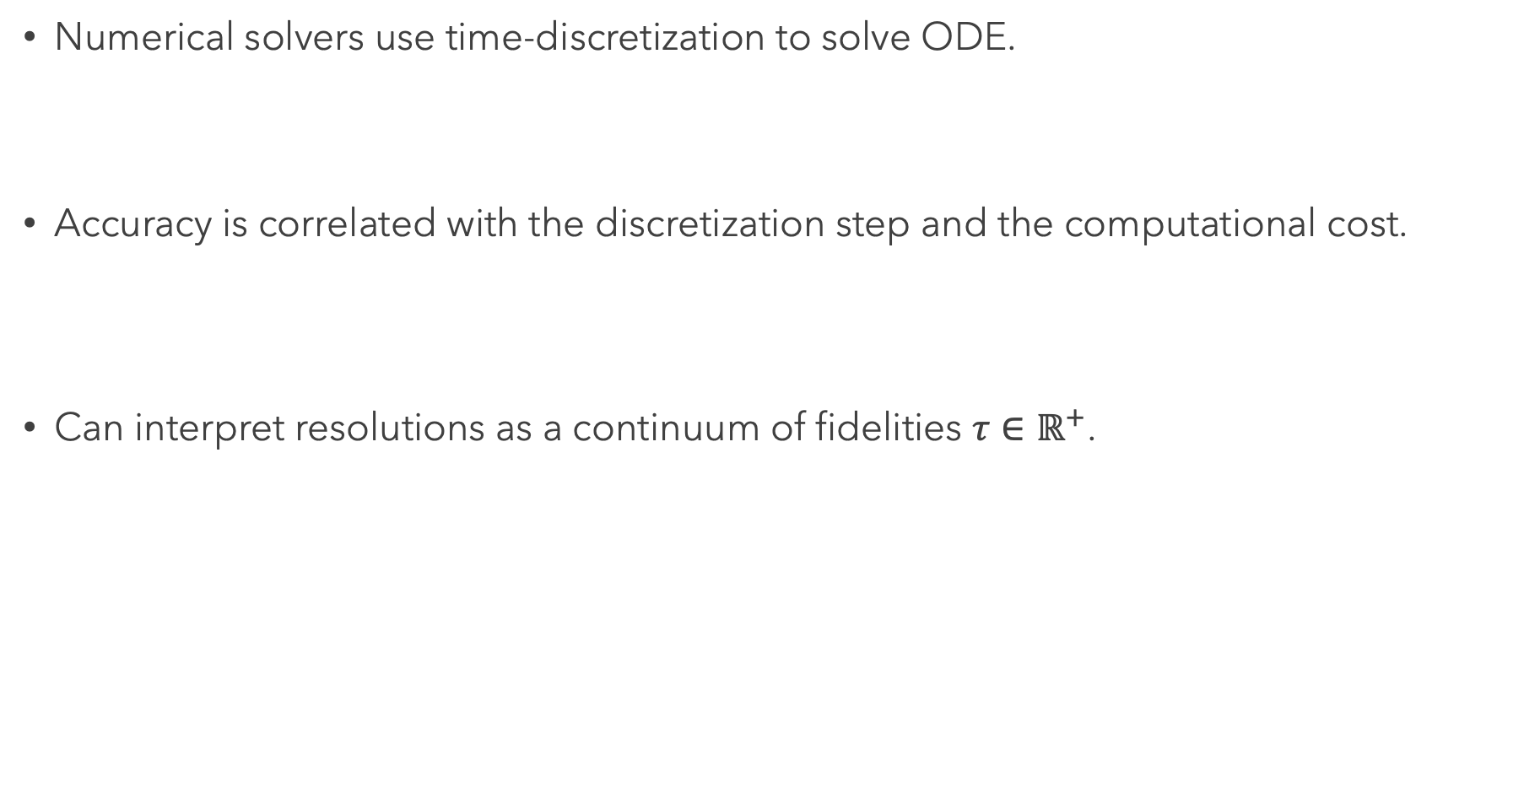
Continuous Multi-fidelity
Numerical solvers use time-discretization to solve ODE.
Accuracy is correlated with the discretization step and the computational cost.
Can interpret resolutions as a continuum of fidelities $τ∈ℝ^{+}$.

Slide 24
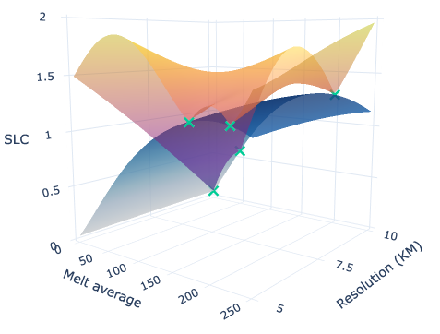
model
Model the parameter and resolution space using a GP (no noise) with an RBF kernel.
Parameters of the kernel define the strength of the correlation between resolution.
Large lengthscale means lower resolution is informative.
Goal is to reduce the uncertainty at the highest resolution.
Notes:
The tighter the lengthscale the tighter the uncertainty bar

Slide 25
Multi-fidelity experimental design
Modeling (previous slides)
How do you model the function as well as the relationship between resolutions?
Decision-making (next slides)
What is the utility to optimize?
How do you choose the next point based on the model?
BO, RL, Online learning, Bandits (all connected)…

Slide 26
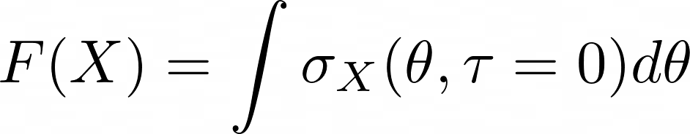
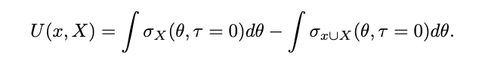
Utility: Conditional integrated variance
Value of a set of points X: conditional integrated variance at the highest fidelity
Value of adding a point: conditional integrated variance reduction

Slide 27
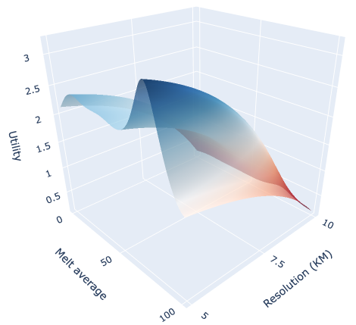
Utility: uncertainty reduction
Integrated variance reduction (at the highest resolution).
Querying the highest fidelity has the highest reward.
Need to adjust the the utility based on the costs.
Constrained optimization problem with a fixed computational budget.

Slide 28
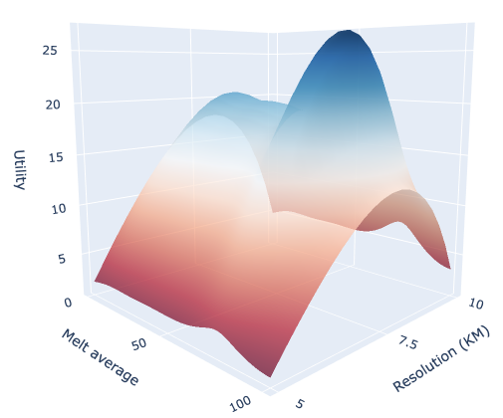
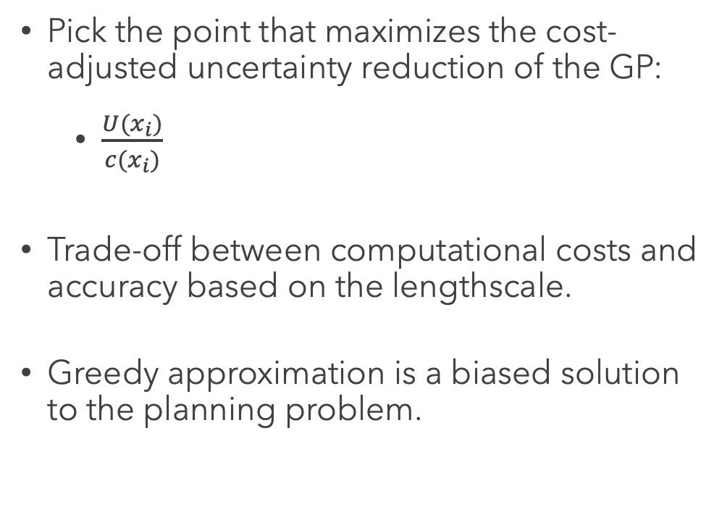
Greedy approximation: Weighted utility
Pick the point that maximizes the cost-adjusted uncertainty reduction of the GP:
$\frac{U(x_{i})}{c(x_{i})}$
Trade-off between computational costs and accuracy based on the lengthscale.
Greedy approximation is a biased solution to the planning problem.
Notes:
Greedy approximation build set one by one. Well see later why that can be a problem

Slide 29
Planning is hard
Goal is to maximize a set function with a constraint on the total cost.
Two issues:
Combinatorial problem.
True utility of a point is not known (access to a noisy version).
We might believe low resolution points are useful at the beginning but realize they are not at the end.
Notes:
assume data comes from a GP with a given lengthscale

Slide 30
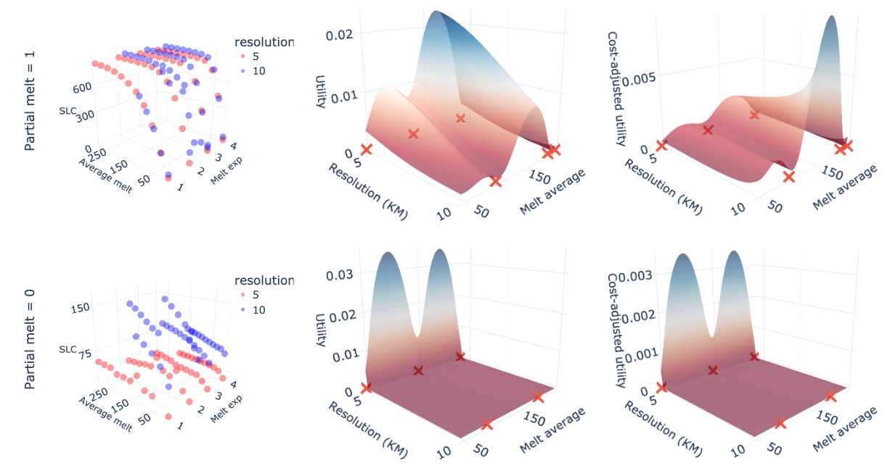
UTILITY on ice-sheet data

Slide 31
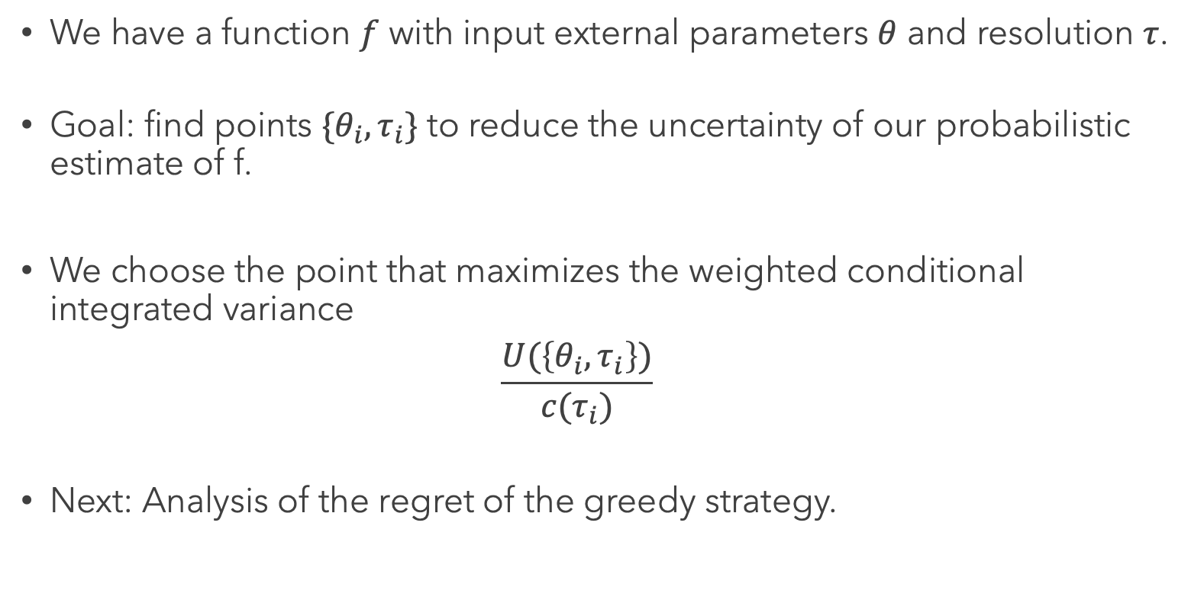
RECAP
We have a function $f$ with input external parameters $θ$ and resolution $τ$.
Goal: find points $\{θ_{i},τ_{i}\}$ to reduce the uncertainty of our probabilistic estimate of f.
We choose the point that maximizes the weighted conditional integrated variance
$$\frac{U(\left\{θ_{i},τ_{i}\right\})}{c(τ_{i})}$$
Next: Analysis of the regret of the greedy strategy.

Slide 32
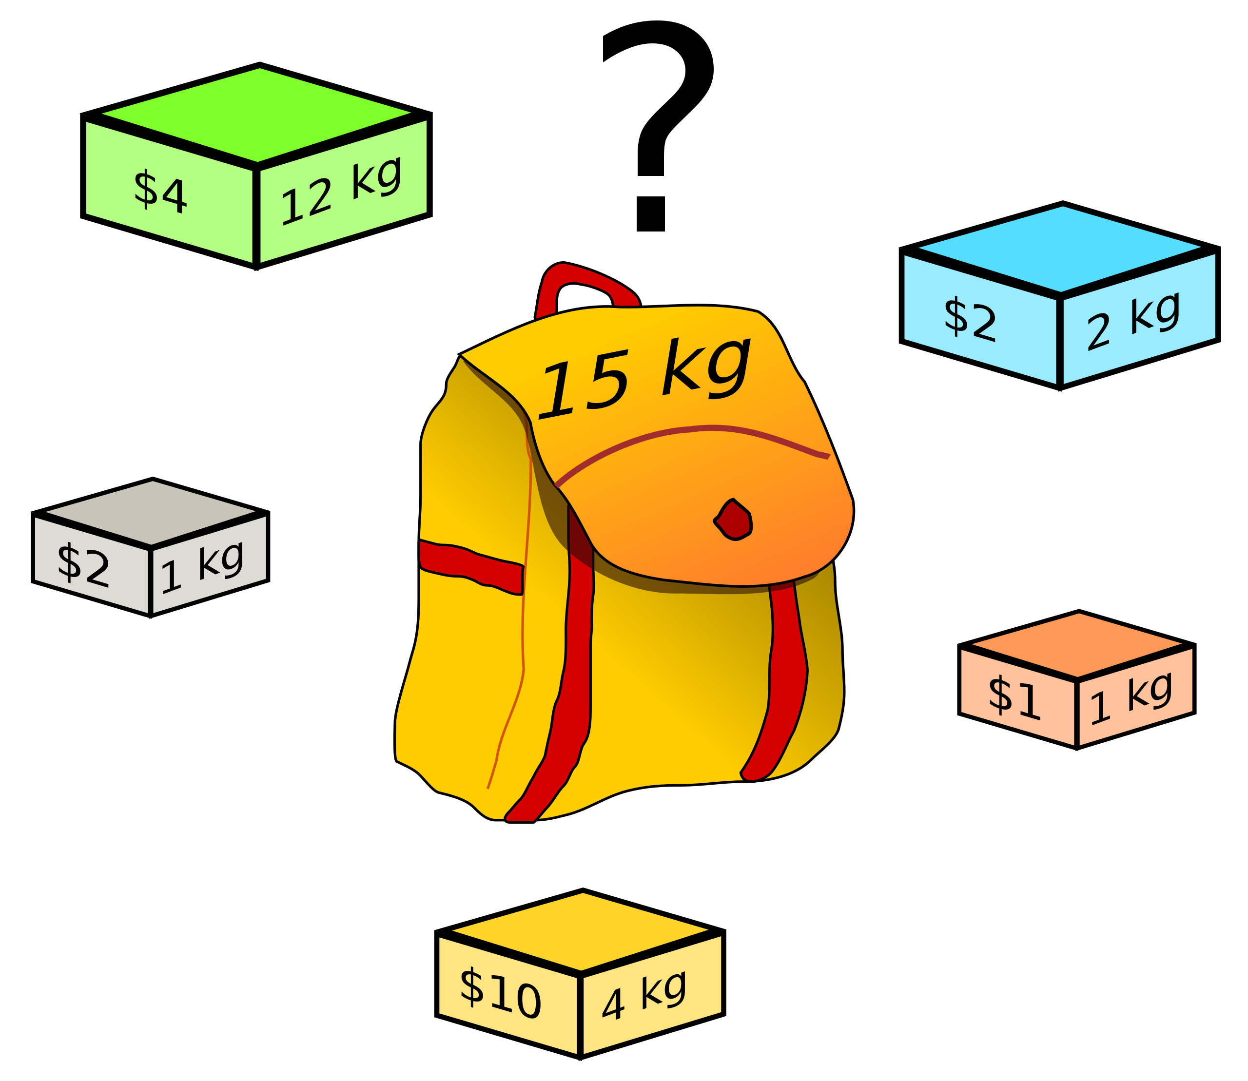
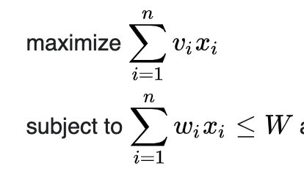
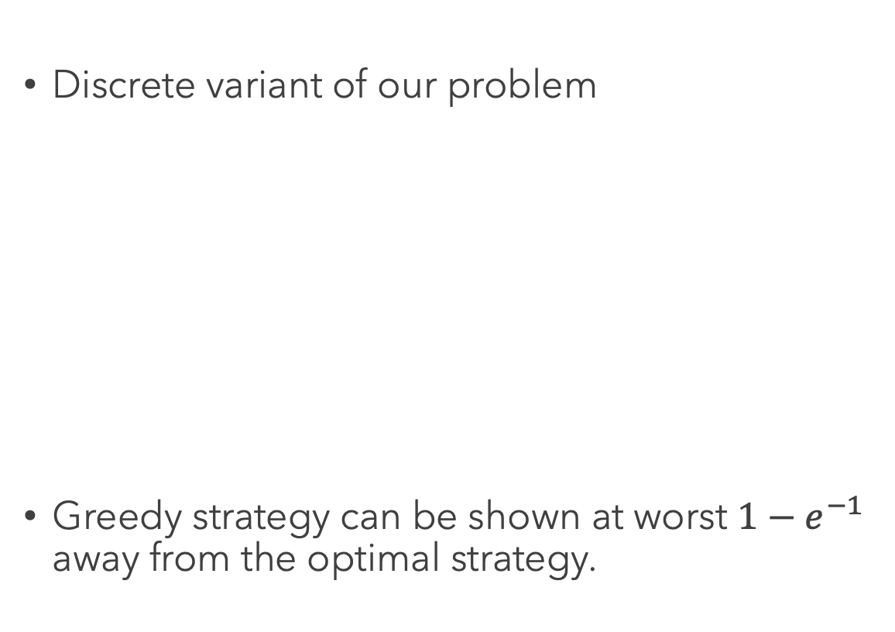
KNAPSACK PROBLEM
Discrete variant of our problem
Greedy strategy can be shown at worst $1−e^{−1}$ away from the optimal strategy.

Slide 33
Set maximization & Sub-modularity
MFED is different because we are working with set function F.
Value of a point is dependent on what is in the set.
Generalization of the knapsack result for set functions if it satisfies the concept of sub-modularity (diminishing returns).
“you have more to gain from something new if you have less to begin with.”

Slide 34
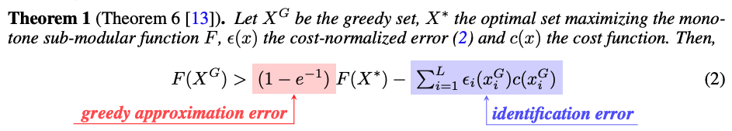
Regret of stochastic greedy strategy
Identification error exists because we don’t know the optimal resolution lengthscale beforehand and can not act perfectly greedily.

Slide 35
Experiments
Apply MFED to simple partial differential equations (notebook).
More extensive result for ice-sheet model (work in progress).

Slide 36
Interesting directions
Apply MFED to interesting physical problems that involve solving differential equations.
Dynamical systems.
Make compute-related decisions in ML “data-driven”
Deep learning: steps in diffusion models, floating point accuracy…
Notes:
Ice-sheet simulator is available in Julia but can be a bit tricky to work with. If you’re interested in working on that let me know.
” Find a problem where the decision about computation allocation is done by human and make it “data-driven”. Computational decisions are everywhere

Slide 37
Improve decision making process
Myopic behaviour due to the greedy strategy.
Leverage partial information using checkpoints to select next points.
Problem-specific modelling choices (i.e. non-stationary kernel).
Currently working on some of this so feel free to email me.

Slide 38
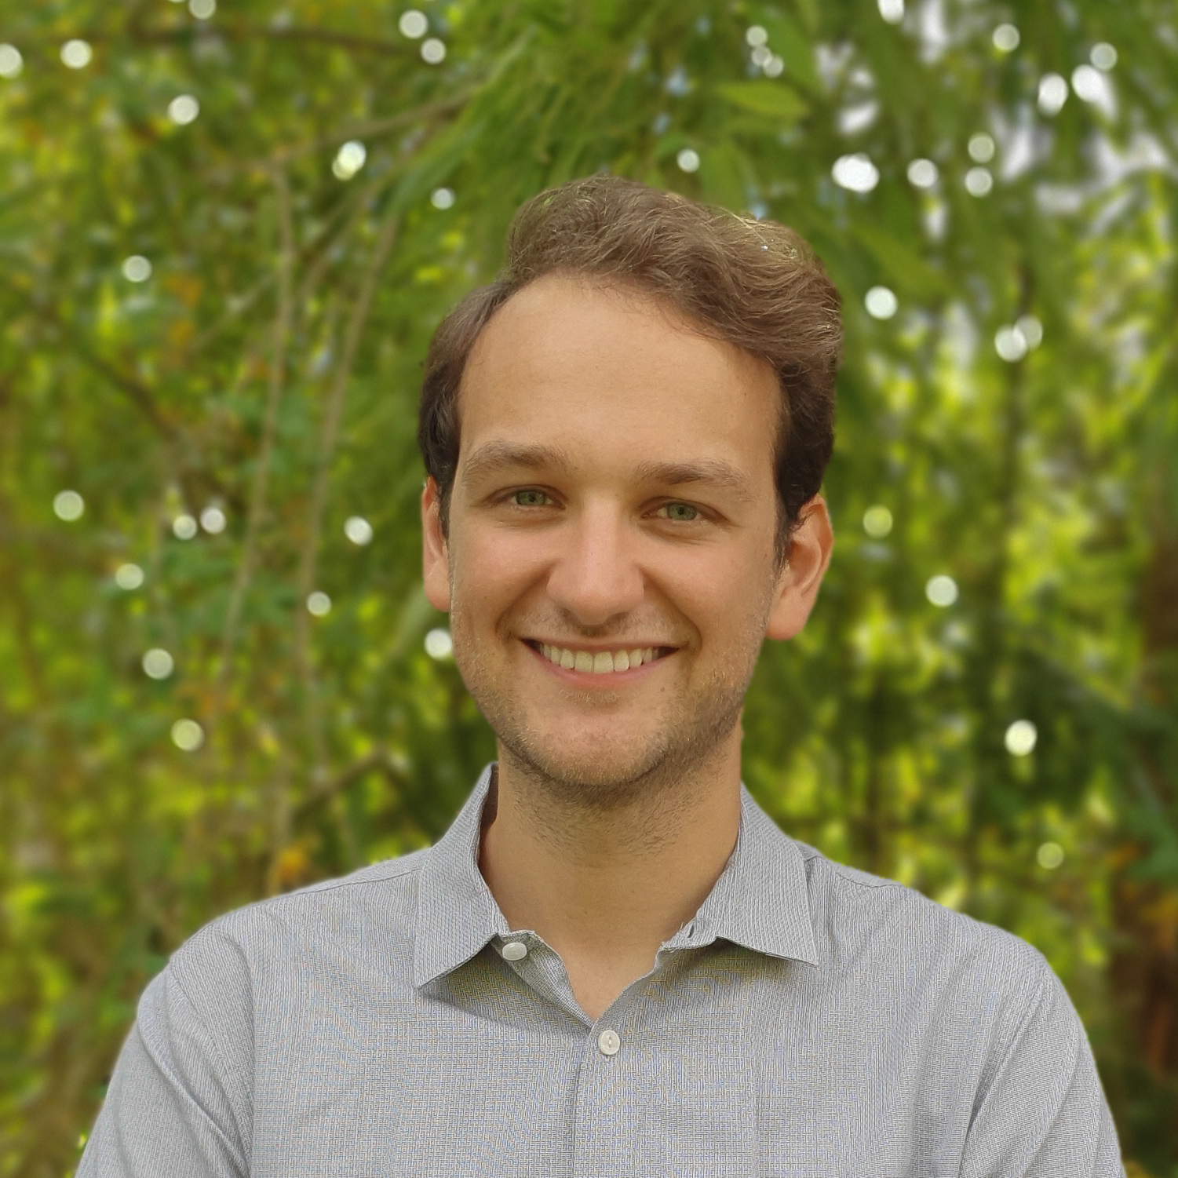

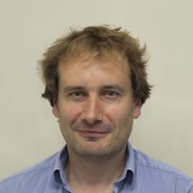
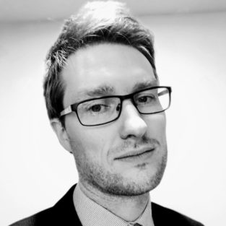


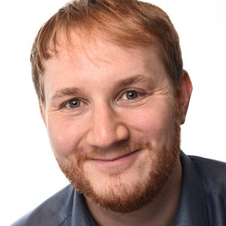
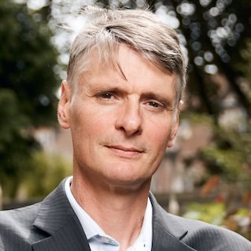
OUR TEAM
Pierre Thodoroff
Rosie Williams
Robert Arthern
Scott Hosking
Computer Lab at the University of Cambridge
British Antarctic Survey
British Antarctic Survey
British Antarctic Survey
James Byrne
Ieva Kazlauskaite
Marcus Kaiser
Neil Lawrence
British Antarctic Survey
Department of Engineering at the University of Cambridge
Computer Lab at the University of Cambridge
Computer Lab at the University of Cambridge

Slide 39
THANK YOU!
Pierre Thodoroff
pt440@cam.ac.uk

Slide 40
References
Multi-fidelity experimental design paper: https://github.com/pierthodo/multi_fidelity_experimental_design/blob/main/Multi_fidelity_experimental_design_ice.pdf
Notebook on simple PDE: https://github.com/pierthodo/multi_fidelity_experimental_design/blob/main/notebook/PDE_explore.ipynb
Glacier flow video: https://www.youtube.com/watch?v=3uoGHrIg7_Y&feature=emb_logo
Ice-sheet loss: https://www.science.org/doi/10.1126/science.aaz5845
Mass balance: https://www.antarcticglaciers.org/
Stokes graph: https://www.antarcticglaciers.org/
Motion of ice: https://wedocs.unep.org/handle/20.500.11822/7792
Experimental design sampling: https://ieeexplore.ieee.org/document/7084698
Multi-fidelity plots: https://emukit.github.io/

